Slide 1
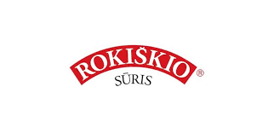




The biggest Companies in Rokiskis region
899 employees
198 employees
140 employees
-
135 employees
129 employees

Slide 2
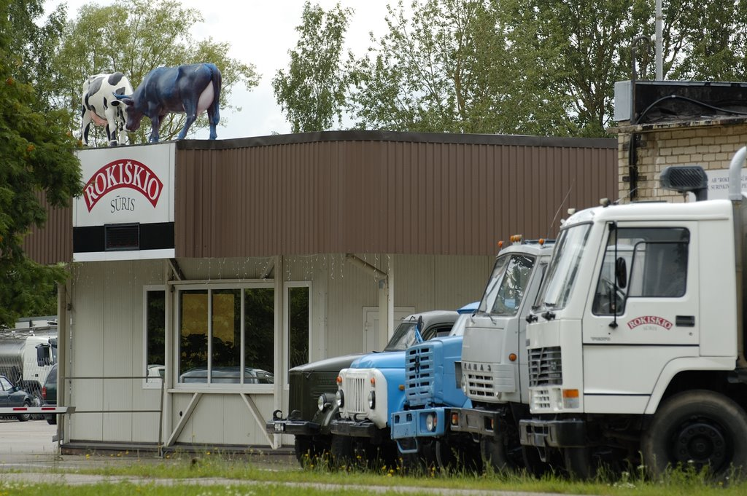
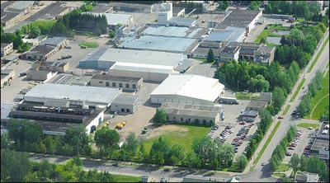
Joint Stock Company “Rokiškio sūris”

Slide 3
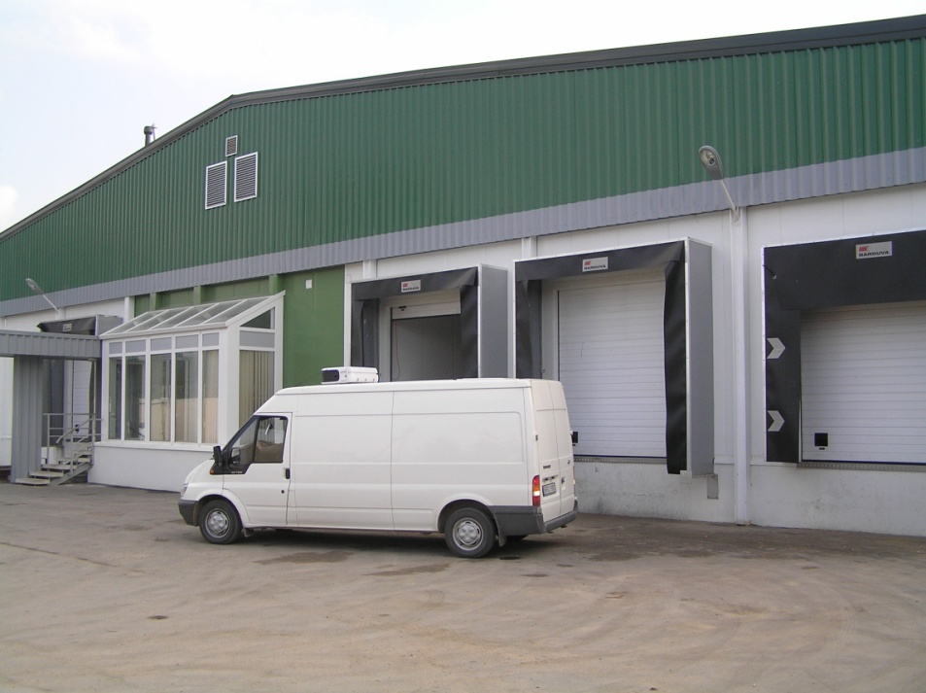
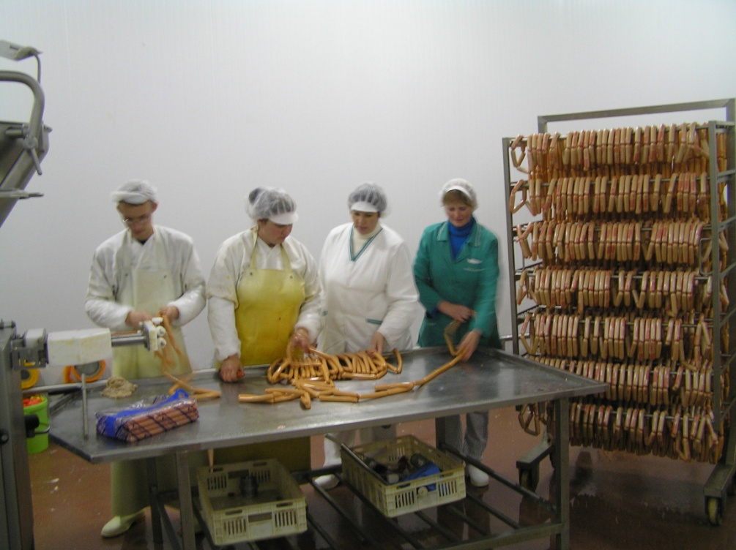
Joint Stock Company „Daivida“ / Rokiškio mėsinė

Slide 4
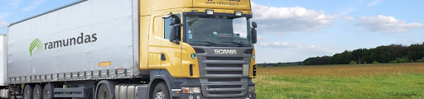
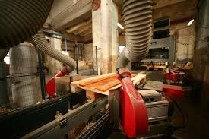
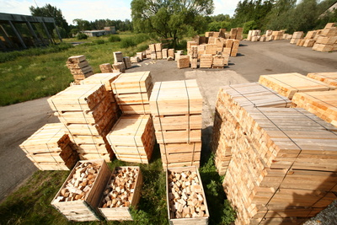
Joint Stock Company „Ramundas GM“

